Slide 1
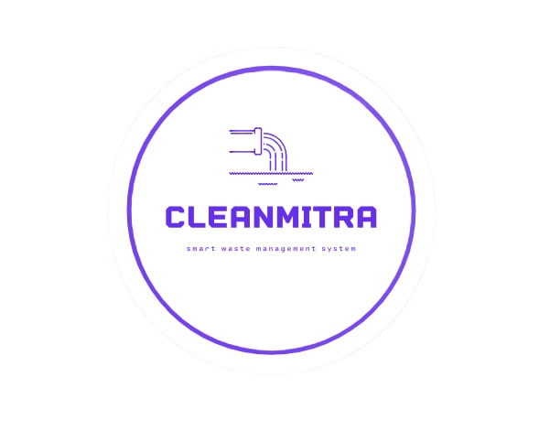

CLEANMITRA
SMART WASTE MANAGEMENT SYSTEM

Slide 2

Team Details
ROLL NO | STUDENTNAMES | TEAM LEAD
2310030232 | UDIT RAJ KUMAR
2310030419 | K. Hema Charan Reddy
2310030441 | M. Nihar Reddy
2310030444 | K. Dheeraj

Slide 3
PROBLEM-STATEMENT
🇮🇳 In India, roads and public areas are often filled with unmanaged waste.
🧹 Citizens are facing sanitation and cleanliness issues daily.
🚫 No dedicated government app or centralized platform to report municipal issues like garbage collection, clogged drains, etc.
📢 People have no clear way to register complaints or get updates on the status.
🕳️ Current reporting is manual or informal (through ward offices or social media).
🕒 Delay in action due to lack of real-time communication between public and municipality.
🔍 No proper tracking, transparency, or accountability in complaint resolution.
📉 Leads to health hazards, bad public image, and environmental problems.

Slide 4
Solution
🧠 We have developed an application called Clear Mitra – Smart Waste Management System.
💻 Currently available as a desktop application built using JavaFX for the frontend and MongoDB as the database.
📱 In the future, we plan to convert this into a mobile application for wider accessibility and ease of use.
🌐 User-friendly interface designed for all age groups with simple navigation and a colorful UI.
💡 The platform allows citizens to:
Report waste and sanitation issues to their local municipality.
Upload images and descriptions of the problem.
Track the status of complaints in real-time.
📬 Reports are stored in the database and can be accessed by municipal staff for quick response.
💸 The application is completely free of cost for users.
📊 Aims to bridge the communication gap between citizens and municipal authorities.
🌍 Promotes a cleaner, healthier environment and encourages active public participation.

Slide 5

OVERVIEW
Our Smart Waste Management System offers a user-friendly application accessible to everyone. It is designed to streamline waste management processes by categorizing users into three roles:
Administrator: Manages system operations, monitors complaints, and oversees overall functionality.
User (Public): Reports waste-related complaints, such as overflowing bins or uncollected garbage, through the app.
Driver: Receives real-time notifications about complaints, navigates to the specified location, resolves issues, and updates the status in the app.
This system ensures efficient communication between users and service providers, enabling timely waste collection and problem resolution, ultimately contributing to cleaner and healthier environments.

Slide 6
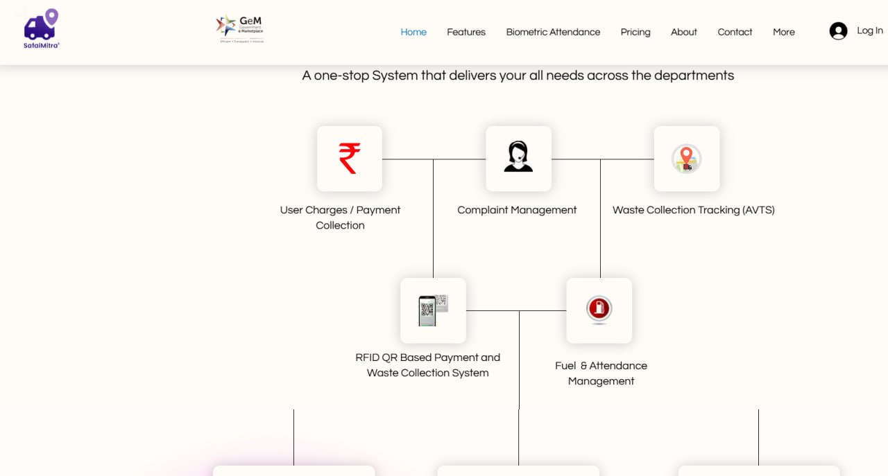
Overview of Existing Solution
No real-time monitoring or feedback system, causing delays in issue resolution.
IoT-enabled apps monitor waste levels in bins but charge high service fees for advanced features.
Apps allow users to report complaints but often involve subscription charges for complete functionality.
Limited real-time coordination between users, administrators, and drivers.
Like SafaiMitra

Slide 7
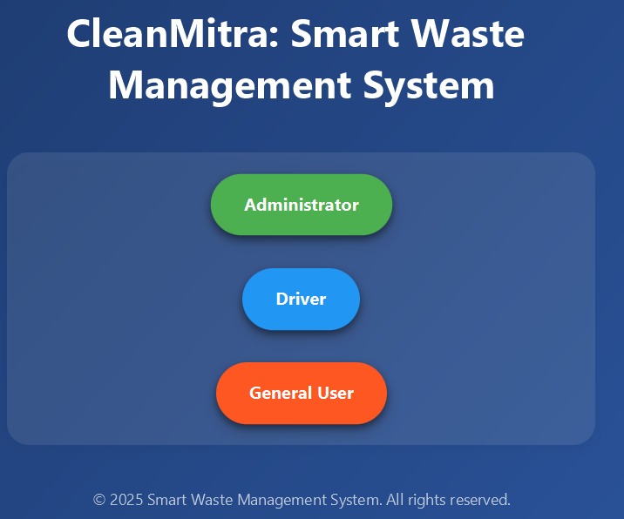
How it Is Different From Existing
Simplified interface, making it easy for users (public) to report complaints and track status.
Tailored for public use, addressing everyday waste management issues in local communities efficiently.
Drivers are notified instantly about complaints, enabling quick action and timely problem resolution.
Provides live updates on complaint status, ensuring transparency for all stakeholders.

Slide 8
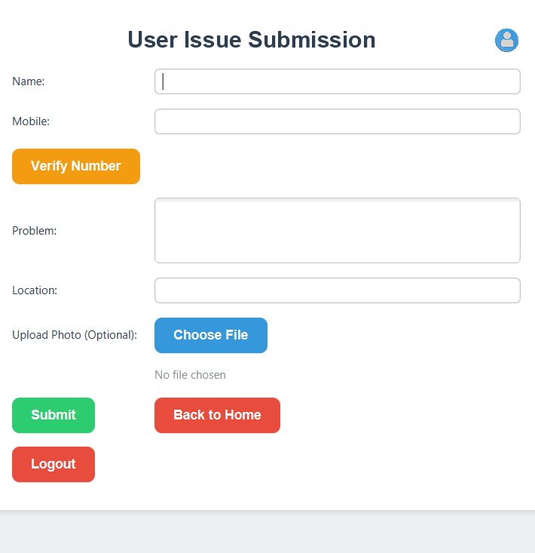
How it Is Different From Existing
Completely free to use(tentative), ensuring all features are available to everyone without any recurring costs.
Free usage encourages higher participation from the public, leading to faster problem resolution and cleaner communities

Slide 9
Programming Language and OOP Principles Used
Advanced Java (JavaFX) is used for developing the Smart Waste Management System.
Encapsulation: Data and methods are bundled into classes like User, Administrator, and Driver to protect sensitive information and maintain modularity.
Inheritance: Common attributes and methods are inherited from base classes, such as a Person class, to reduce redundancy.
Polymorphism: Enables dynamic behavior, such as displaying role-specific functionalities (e.g., user vs. driver actions).
Abstraction: Abstract classes and interfaces define the core functionalities (e.g., complaint handling) while hiding unnecessary implementation details.

Slide 10
Software and Tools
Database:
Currently using local storage for temporary data handling.
Planning to migrate to MongoDB, a NoSQL database, for scalable and efficient data storage and management.
Framework : JavaFX is used for building the front-end interface, offering interactive and user-friendly features.
IDE : IntelliJ IDEA is used for development, providing advanced coding, debugging, and deployment tools for efficient programming.
Future Integration:
MongoDB Atlas for cloud-based database management to enable global accessibility and data security.

Slide 11
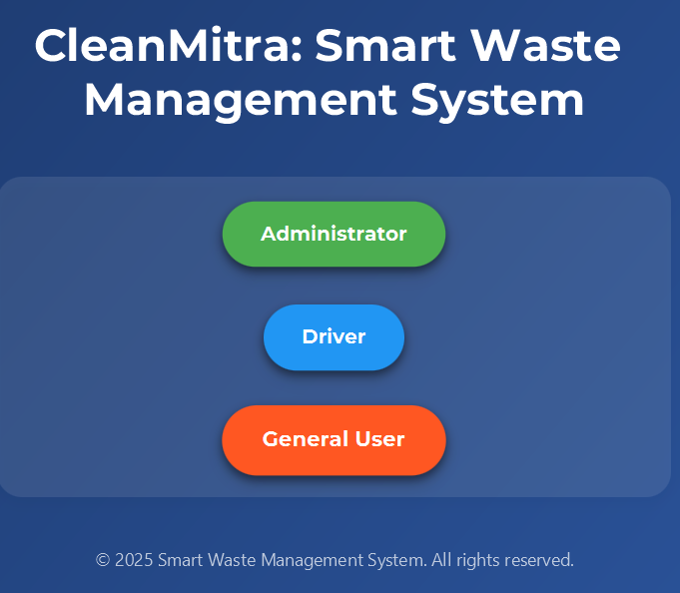
INTERFACE

Slide 12
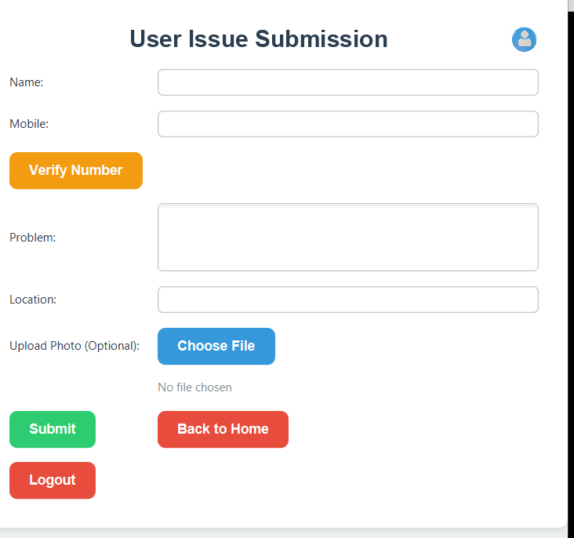
HOW TO USE?
General User Interface
General User – Steps to Report an Issue:
🚪 Open the Clear Mitra Desktop Application.
🧭 On the home screen, select "General User".
🔐 Login or Register to access the platform.
📝 Fill out the problem form:
Name, Email, Phone Number
Description of the Issue
Upload Proof Image
📤 Click on "Submit Issue".
📡 The issue is directly sent to the Admin for review.
🔙 Options to Logout or Go Back available for navigation.

Slide 13
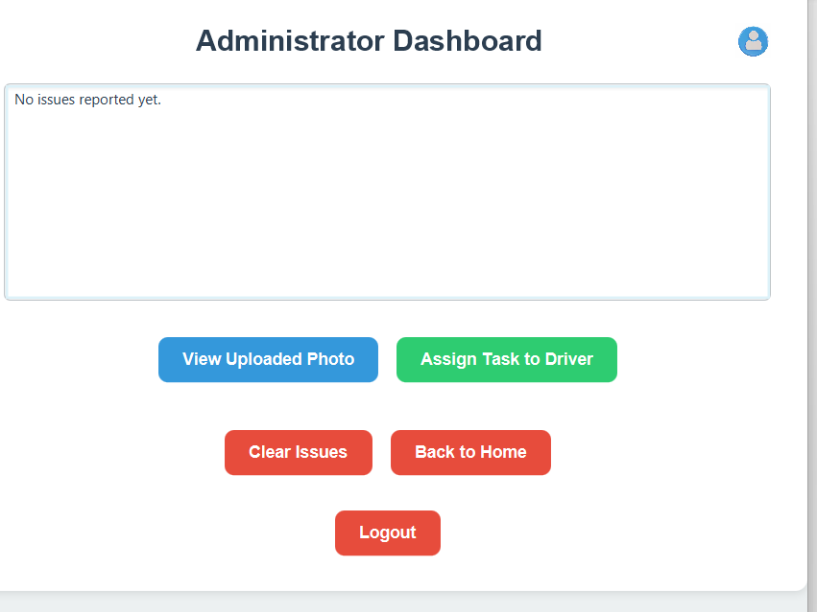
HOW TO USE?
Administrator – Managing Reports:
🔐 Select "Admin" and Login with special admin credentials.
🔑 A unique Admin Code is required for access.
📬 Admin can view all issues reported by general users.
✅ Each issue is verified by the admin.
📋 Admin assigns tasks to available Drivers.
🛰️ Admin uses task details and location to coordinate cleanup efforts.

Slide 14
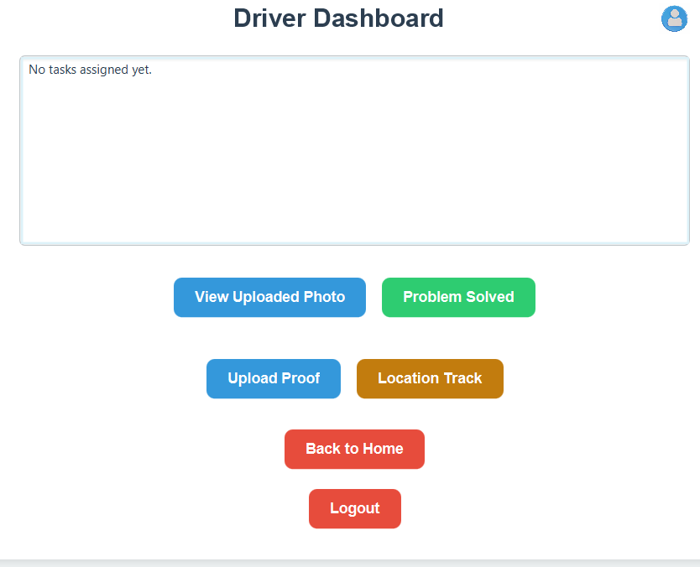
HOW TO USE?
🚛 Driver – Completing Assigned Tasks:
🚀 Click on "Driver" and Login using the provided Driver Code.
🗂️ Driver receives task details assigned by the Admin.
🗺️ Uses Google Maps integration to reach the problem location.
🧹 Completes the assigned waste management task.
📸 Uploads proof of task completion through the app.
📲 User receives a notification that their issue has been resolved.

Slide 15
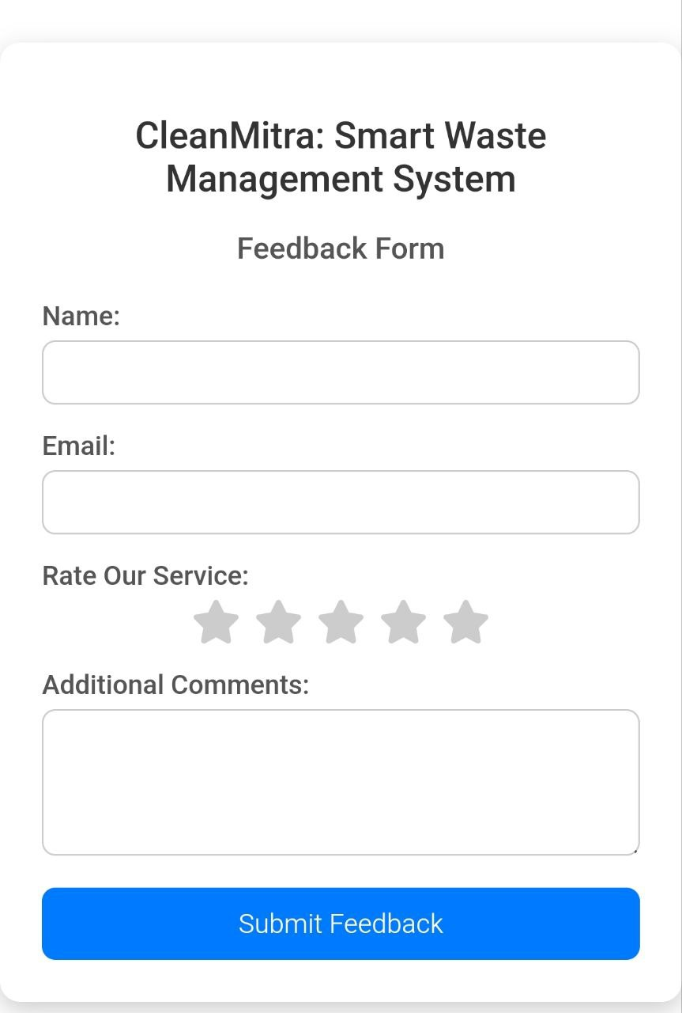
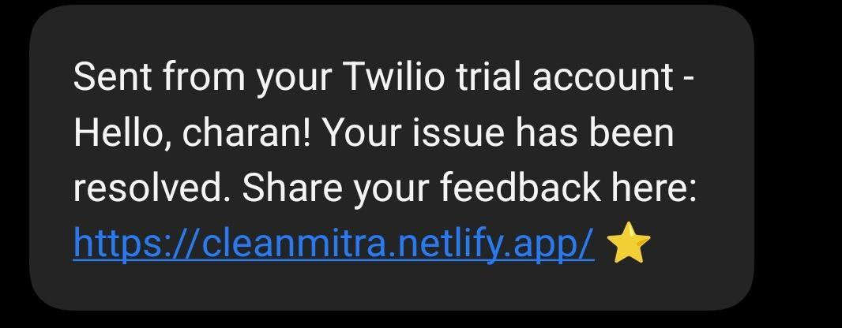
NOTIFICATION PAGE

Slide 16
Conclusion
The Smart Waste Management System is a comprehensive solution aimed at revolutionizing waste management through automation, efficiency, and user engagement.
This project not only streamlines the waste collection process but also empowers users and authorities to collaborate effectively for cleaner and more sustainable environments.
The Smart Waste Management System provides an innovative and sustainable approach to waste management, promoting environmental responsibility and enhancing community well-being

Slide 17

THANK YOU

